Slide 1
Why we should be “Agile”
By Matthew Trembley
Notes:
Hello everyone, my name is Matthew Trembley and I’m here to reason with you on why we should switch to an Agile project management methodology, more specifically Scrum-agile.

Slide 2
What is “Agile”?
“Agile software development is an umbrella term for a set of frameworks and practices based on the values and principles expressed in the Manifesto for Agile Software Development and the 12 Principles behind it” (Agile Alliance, 2021)
Agile is a broad term
Scrum-agile approach
Notes:
Now just a rough definition of what “Agile” means in this context. Agile software development is an umbrella term for a set of frameworks and practices based on the values and principles expressed in the Manifesto for Agile Software Development and the 12 Principles behind it. Essentially, Agile is a pretty broad term, so we are going to dive into “Scrum”. Scrum is it’s own “framework” within Agile, and is amongst the most popular.

Slide 3
What is “Scrum-agile”?
A framework within the Agile methodology.
“Scrum, is, by definition, an empirical process as opposed to a ‘defined and predictive process’” (Cobb, 2015).
Control the process by making changes and reviewing along the way
Now how does it work?
Notes:
So what exactly is Scrum and what does it have to do with Agile? Well more specifically, it is a framework within the Agile methodology. And it is by definition an empirical process. An empirical process can be controlled by making changes to it and reviewing it as the project progresses. This is incredibly important when it comes to software development. So, how does Scrum work?

Slide 4
The Roles
Scrum Master
Facilitates the “Scrum events”
Helps team as a servant-leader
Product Owner
The “business analyst”
Maximizes value of project to stakeholders
Product Backlog
Team Role
Developer – as the title says: they develop!
Notes:
Well first we have some roles to fill. First off, the Scrum Master. This person isn’t necessarily in charge like the title may imply. Really the main job of a Scrum Master is to help facilitate the events of Scrum like Sprints, Daily Scrum Meetings, Sprint Reviews, and Sprint Retrospectives for example. The Scrum Master really helps the team to fill in all the missing areas. The Product Owner is going to be the “business analyst” of the team. The PO will be in charge of maximizing the value of the project in all its forms to stakeholders and “upper management”. The PO will help create the Product Backlog, which is essentially the log of all system requirements from the client that need to make it into the final project. No need to fear, as these requirements can change and are not set in stone.
Last, we have the overall team role. This is where our developers are. The ones who really get the project in motion, as they are self-organizing and self-motivated to see the project progress.

Slide 5
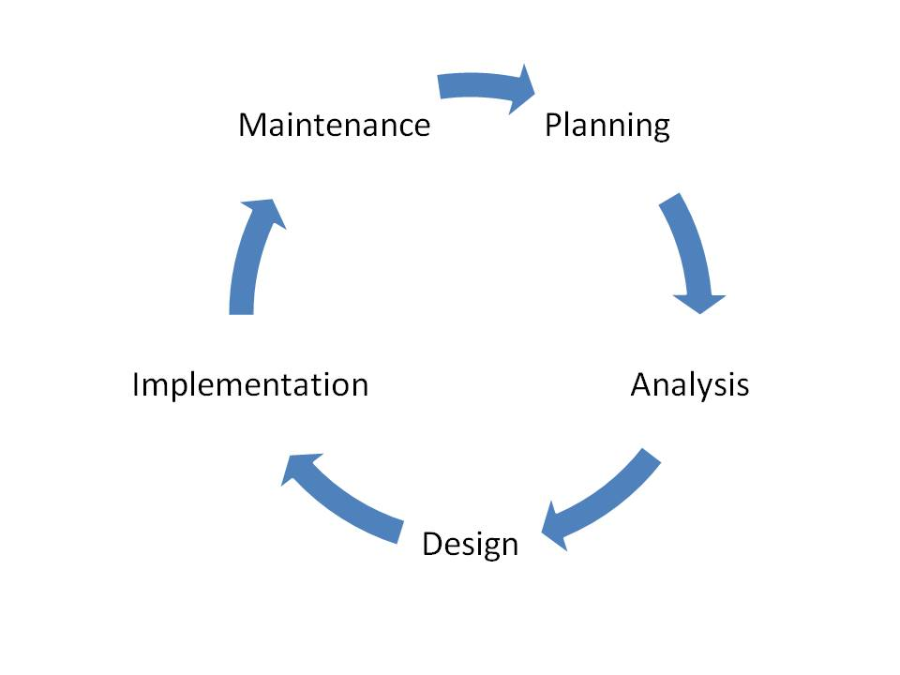
The Software Development Life Cycle(SDLC)
Planning
Requirements and overall scope
Analysis
Research and determine end-user needs
Design
Where Developers will outline the system, network, and databases
Implementation/Development
From chart to code, Developers will create the program
Testing will occur in this stage
“theoretically ready for market” (Preston, 2021)
Maintenance
Where program will be maintained with end-user requests.
This Photo by Unknown Author is licensed under CC BY-SA
Notes:
Here we have the general software development life cycle. This is a generic overview, but it does the job. First we have the Planning stage, where requirements from the client is gathered and where we will have some possible date estimations. Next will be the Analysis stage, which is where research will be conducted depending on the requirements and where the team will determine the what the end user will be expecting. After that in the design stage, the team will the start creating model diagrams and rough drafts of the overall interface. They will also decide what will need to be used in terms of network and databases. Next, the implementation and development stage, where developers were work to actually create the program. This will be paired with testing and by the end of it should have a product ready to present. Last, the maintenance stage, where the program will essentially live out the rest of its life unless major updates are required, but will just be minor updated pending end-user feedback.

Slide 6
What about waterfall?
“A plan-driven or waterfall project attempts to reduce the level of uncertainty associated with the project to a very low level before the project starts” (Cobb, 2015).
Because planning is done at the beginning, change in requirements is not handled very well after project starts
Some projects have enormous amount of uncertainty, which Agile allows and compensates for.
“…agile project management approaches typically defers planning decisions to ‘the last responsible moment’ ”(Cobb, 2015).
The compensation for uncertainty
Allows for some big decisions to be made throughout the whole SDLC as obstacles arise.
“Clients valuable feedback cannot be included with ongoing development phase” (guru99, 2019).
Waterfall does not allow for client feedback while product is in development because planning has already been done
Agile welcomes feedback
Notes:
Well so what about waterfall project management? Well, the main idea of waterfall is that the planning happens before the project begins. This is where the benefit of Agile comes in. Agile will allow for important decisions to be made at sometimes last minute. This leaves a lot of uncertainty up to be solved from day to day as problems arise.

Slide 7
Now what to choose?
Agile
Flexibility – hence “Agile”
Iterative development process – “Sprints”
Creates team environments by working together
Everyone is accountable for project success
Waterfall
Somewhat “set in stone” after planning
Major development done in large chunks
Harder to debug = more costly
Doesn’t necessarily allow for “teams”
Do the part your responsible for and nothing else.
Notes:
Now which one do we choose? Well as you can see, here are some major points of both methodologies. The one I would like to point out under Agile is “team environments”. This is pretty important, as a team that works well together can accomplish great things. And not only this, but in Agile there is no finger pointing. If for some reason the project fails, it is everyone’s fault. Everyone is accountable for the project success.

Slide 8
In my experience:
Agile allowed for the client, SNHU Travel, to change requirements
Team was able to quickly accommodate
Agile uses “User Stories” to help create iterative development
Finished in time-boxed Sprints
Allows to prioritize features that will be installed first
Agile allows for team to communicate daily
“Daily Scrum”, where the team will individually let everyone know where they are in terms of progress and/or impediments

Slide 9
References
Agile Alliance. (2021, December 2). What is Agile Software Development? Retrieved December 7, 2021, from https://www.agilealliance.org/agile101/
Charles G. Cobb. (2015). The Project Manager’s Guide to Mastering Agile : Principles and Practices for an Adaptive Approach. Wiley.
guru99. (2019, April 4). What is Waterfall Model in SDLC? Advantages & Disadvantages. Guru99.com. https://www.guru99.com/what-is-sdlc-or-waterfall-model.html
Preston, M. (2021, January 21). 7 Phases of the System Development Life Cycle Guide. Www.clouddefense.ai. https://www.clouddefense.ai/blog/system-development-life-cycle

